Slide 1

Rivers of North America
Alberta “Albi” Kovatcheva

Slide 2
Task
The built-in data set rivers has the length in miles of 141 major rivers in North America. You can build a data frame of this data set that is suitable for graphing as follows: rr = data.frame(rivers)
Using the following command will provide the first 6 rows of data in the data frame, it should look something like this: head(rr)
Create a histogram with suitable bin widths, a box plot, and a normal probability plot. Then answer the following questions:

Slide 3
Questions
Are there any outliers in this data set? Are they high or low outliers?
Do these data appear to come from a normal distribution?

Slide 4
Accessing the Data & Building the Data Frame
Code to Access Data & Build Data Frame:
# Access the built in data set 'rivers' which has the length in miles of 141
# major rivers in North America.
View(rivers)
# Build a data frame of this data set that is suitable for graphing:
rr <- data.frame(rivers)

Slide 5
Display the First 6 Rows of the Data Frame
Code to display the first 6 rows of the data frame:
# Display the first 6 rows of data in the data frame:
head(rr)
rivers
1 735
2 320
3 325
4 392
5 524
6 450

Slide 6
Summary Statistics
 | Length (miles)
Minimum | 135.0
1st Quartile | 310.0
Median | 425.0
Mean | 591.2
3rd Quartile | 680.0
Maximum | 3710.0

Slide 7
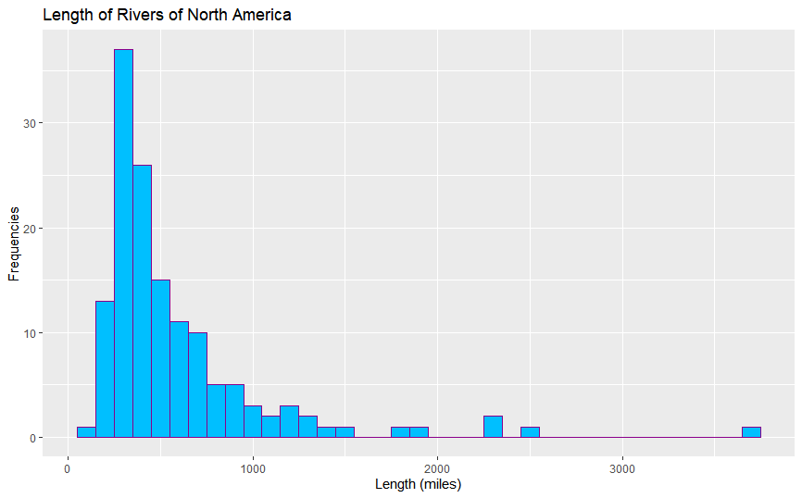
Histogram
Code to create this histogram:
# Histogram
H <- ggplot(rr, aes(x = rivers))
H + geom_histogram(binwidth = 100, fill = "deepskyblue", color = "darkmagenta") +
ggtitle("Length of Rivers of North America") +
xlab("Length (miles)") + ylab("Frequencies")

Slide 8
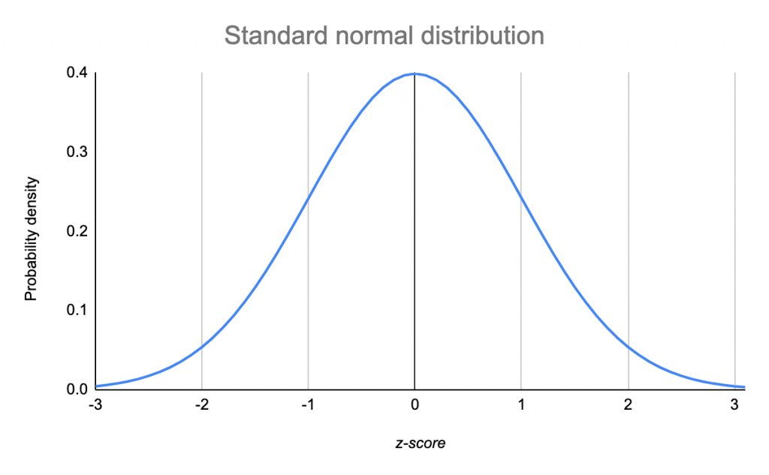
Analysis
Because the histogram of the length of rivers in North America does not approximate a bell curve, the histogram shows that the data is severely skewed and not normally distributed.

Slide 9
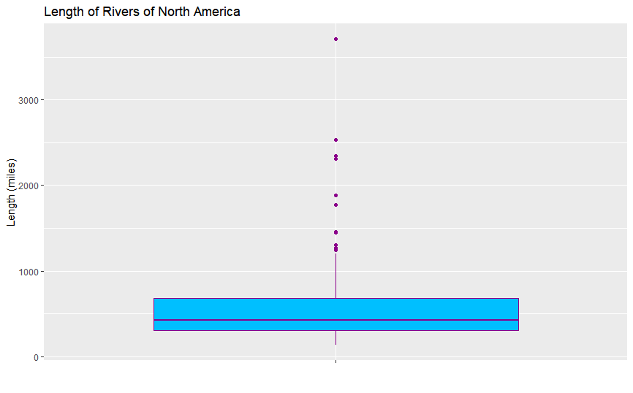
Box Plot
Code to create this box plot:
B <- ggplot(rr, aes(x = " ", y = rivers))
B + geom_boxplot(fill = "deepskyblue", color = "darkmagenta") +
ggtitle("Length of Rivers of North America") +
xlab(" ") +
ylab("Length (miles)")

Slide 10

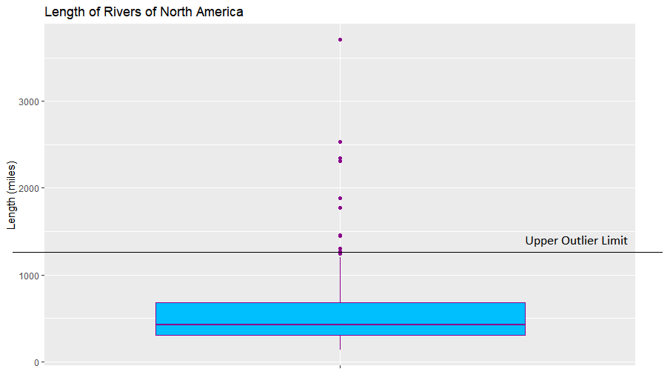
Analysis
Any data beyond the upper and lower outlier limits are considered outliers. Below is a mathematical assessment of the outliers of this data set.
1st Quartile = 310.0
3rd Quartile = 680.0
IQR = 680.0 - 310.0 = 370.0
IQR * 1.5 = 370.0 * 1.5 = 555
Lower Limit = 310.0 – 555 = -245
Upper Limit = 680.0 + 555 = 1,235
Because all the outliers are high, they inflate the mean significantly.
Mean with outliers: 591.2 miles
Mean without outliers: 477.4 miles
 | Length (miles) With Outliers | Length (miles) Without Outliers
Minimum | 135.0 | 135.0
1st Quartile | 310.0 | 302.2
Median | 425.0 | 408.5
Mean | 591.2 | 477.4
3rd Quartile | 680.0 | 603.8
Maximum | 3710.0 | 1205.0

Slide 11
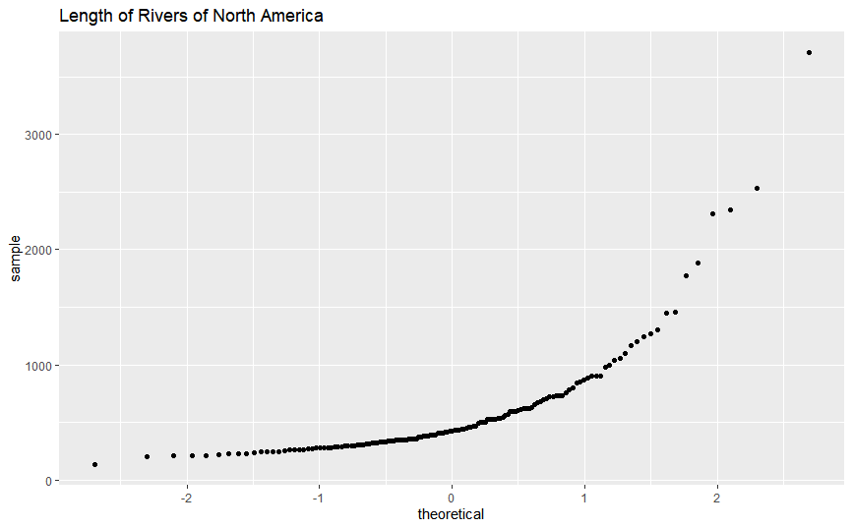
Normal Probability (QQ) Plot
Code to create this QQ plot:
# QQ Plot
QQ <- ggplot(rr, aes(sample = rivers))
QQ + geom_qq() + ggtitle("Length of Rivers of North America")

Slide 12
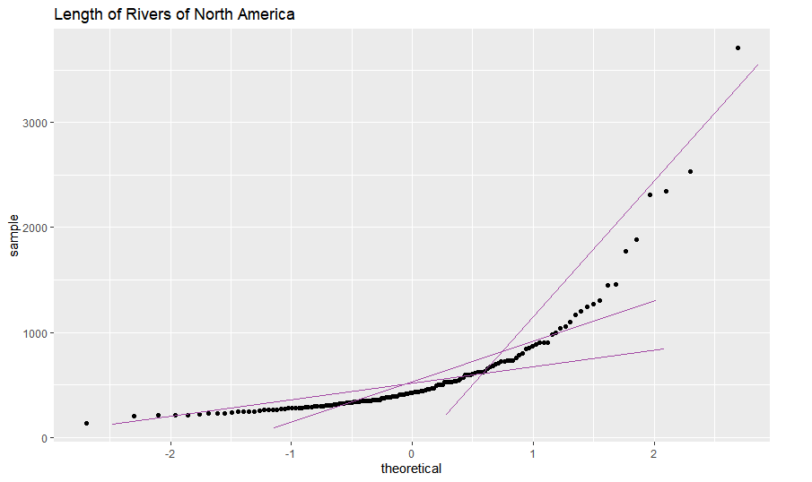
Analysis
QQ Plot explained:
Theoretical: The data set, as if it were part of a standard normal distribution.
Sample: The actual data.
If the data in the QQ plot were approximately linearly distributed, it could be considered normally distributed. However, this is not the case.

Slide 13
Answers
1. Are there any outliers in this data set? Are they high or low outliers?
Based on the Box Plot, there are outliers in this data set, and they are high outliers.
2. Do these data appear to come from a normal distribution?
Based on the histogram, the data does not appear to be normally distributed.
Upon further examination of the QQ Plot, the data fails the “fat pencil test.” Since the data in the QQ plot does not approximate a straight line, the data is not normally distributed.

Slide 14
Conclusion
The length of rivers in North America significantly varies and is not normally distributed.

